Slide 1
Chapter 2
Instructions: Language of the Computer
Notes:
The University of Adelaide, School of Computer Science
Chapter 2 — Instructions: Language of the Computer

Slide 2
Registers vs. Memory
Registers are faster to access than memory
Operating on memory data requires loads and stores
  More instructions to be executed
Compiler must use registers for variables as much as possible
  Only spill to memory for less frequently used variables
  Register optimization is important!
Chapter 2 — Instructions: Language of the Computer — <number>
Notes:
The University of Adelaide, School of Computer Science
Chapter 2 — Instructions: Language of the Computer

Slide 3

Register Spilling
Spilling is a process by which caller function stores extra arguments into the stack
The compiler need to determine these arguments and make use of them in the procedure as required by loading them from the memory
Chapter 2 — Instructions: Language of the Computer — <number>

Slide 4
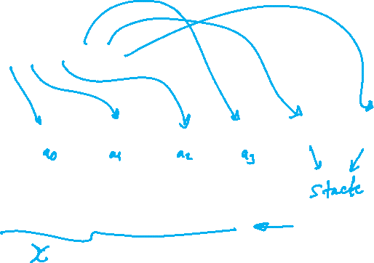
Example
Example
  int main(){
  foo(1,2,3,4,5,6)
  }
  int foo( int a, int b, int c, int d, int e, int f ) {
  int x = 0;
  x = a + b + c + d + e + f;
  return c;
  }
Chapter 2 — Instructions: Language of the Computer — <number>

Slide 5
$v0 | $sp | $ra
 | 200 | 40
00 | main: addi sp, sp, -8
04 | addi $a0, $0, 1
08 | addi $a1, $0, 2
12 | addi $a2, $0, 3
16 | addi $a3, $0, 4
20 | addi $t0, $0, 5
24 | addi $t1, $0, 6
28 | sw $t0, 0($sp)
32 | sw $t1, 4($sp)
36 | jal foo
40 | Add $s0, $0, $v0
… | ……………………………
100 | Foo: add $v0, $a0, $a1
104 | add $v0, $v0, $a2
108 | add $v0, $v0, $a3
112 | lw $t0, 0($sp)
116 | lw $t1, 4($sp)
118 | add $v0, $v0, $t0
122 | add $v0, $v0, $t1
126 | add $sp, $sp, 8
130 | jr $ra
Stack
200
196
192
188
184
180
176
172
168

